Slide 1

Developing AI-Based Comprehensive Framework for Online Assessments
Group No: 24 Swapnil Sapre : 18104027 Kunal Shinde : 18104012 Keval Shetta : 18104013
Guide : Prof Vishal Badgujar

Slide 2
Contents
Introduction
Objectives
Problem Deﬁnition
Technological Stack
Review Suggestions (Given in Last meeting)
Proposed System Architecture/Working
Prototype Design Demonstration
Implementation Status
Status of Paper Draft & Targeted Conference

Slide 3
Introduction
Problems Identiﬁed :
Inability to conduct in person exams in situations like pandemic.
Malpractices done by students by taking advantage of no proctoring methods during exam.
Personal monitoring of students required that takes more time and not easily manageable
Problem of Impersonation
Student management in terms of marks record and question bank management in terms of setting question paper.

Slide 4
Introduction
Solution Proposed :
With proctoring enabled the chance of students doing malpractices reduces by a huge amount.
The AI and ML based proctoring mechanism will auto detect the malpractices. Hence no need to individually monitor students.
For impersonations, live facial validation of actual examinee before the exam.
Making use of OTP or secret password based authentication mechanism instead of simple username-password.
Enabling webcam and microphone for video & audio detection and tab locking to prevent browsing activities.

Slide 5
Objectives
To set up proctoring mechanism to stop malpractices in exam. To create a system that validates each user well before the exam using facial recognition and validation.
To perform object tracking (person tracking) throughout the exam.
To allow the examiner to alert warnings or end the exam if students found performing malpractices.
To provide a platform for the teachers to set the questions and get detailed reporting.
To provide tab locking features to not allow students to navigate away from exam screen.
To send attendance and mis activity report details to teacher's.

Slide 6
Technology Stack
Proctoring Tools + Libraries
Front End
Backend
Frameworks
Database
Pyaudio / NLTK (for audio)
Ajax
Bootstrap
HTML5
PHP
TimeCircles
MySQL server
OpenCVkaggle
CSS
Python
Flask
Yolo weights

Slide 7
Review Suggestions
Ability to save the exam in progress in case of power or internet interruptions.
Make a downloadable version of application (to be downloaded from website using link)

Slide 8
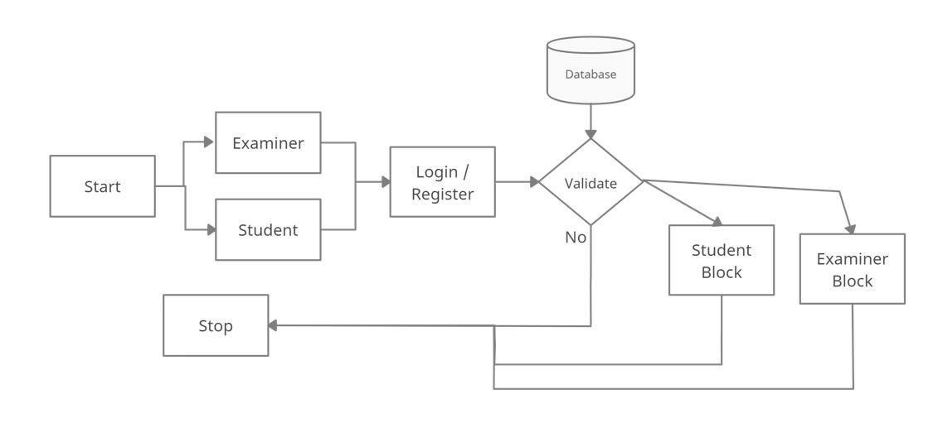
Proposed System Architecture

Slide 9
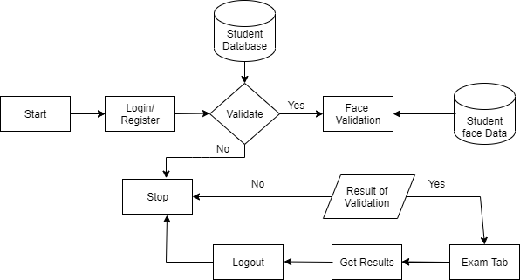
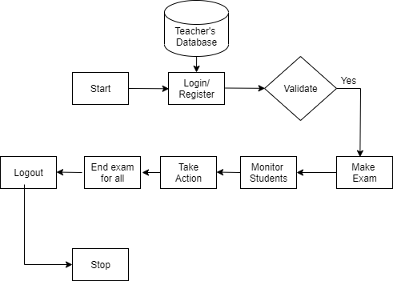
Student’s End block diagram
Teacher’s End block

Slide 10
Prototype Design Demonstration
https://swapnilsapre.proto.io/player/index. cfm?id=45612231-f54e-4cb9-af6e-216ff5e0fdd5

Slide 11
Implementation Status
Pose setup, face recognition and validation partially done (objective 1)
Object tracking in progress (objective 2)
Setting up a dashboard for teachers to set up question paper in progress (objective 4).

Slide 12
Status of Paper Draft & Targeted Conference
Paper completed , approved by guide and submitted in following conferences
3rd International Conference on Advances in Distributed Computing and Machine Learning (ICADCML)-2022
More Details : https://www.icadcml.in/#proc
3rd International Conference on Deep Learning, Artiﬁcial Intelligence and Robotics, (ICDLAIR) 2021
More Details : https://icdlair2021.iaasse.org/index.html
International Conference On Big Data, Machine Learning and Applications
More Details : http://bigdml.nits.ac.in/

Slide 13
Status of Paper Draft & Targeted Conference
Paper completed , approved by guide and submitted in following conferences
2nd International Conference on Ubiquitous Computing and Intelligent Information Systems [ICUIS 2022]
4th International Conference on Computer Networks, Big Data and IoT ICCBI 2021.
More Details : http://icocbi.com/2021/submission.html

Slide 14
Thank You...!!

